Slide 1

Narasaraopet Engineering College (autonomous)
Logo Infringement Detection using CNN
Under the estimated guidance of
Dr. K . Lakshminadh M.Tech ,Ph.D.
Team members
Sk. Karishma (19471A05I1)
Y. Lakshmi Priya (19471A05J5)
S.supriya (19471A05H8)

Slide 2
Abstract
In this project we propose a method for logo recognition based on Convolutional Neural Networks, instead of the commonly used key point - based approaches.
The method involves the selection of candidate sub windows using an unsupervised segmentation algorithm, and the SVM-based classification of such candidate regions using features computed by a CNN.
For training the neural network we augment the training set with artificial transformations, while for classification we exploit a query expansion strategy to increase the recall rate.
Experiments were performed on a publicly-available dataset that was also corrupted in order to investigate the robustness of the proposed method with respect to blur, noise and lossy compression.

Slide 3
Introduction
This project deals with finding fake logo by matching and recognizing it with the original logo.
This is done by dividing the image of logo into rows and columns and thus each cell has its index value .
Taking the index value of each cell which belongs to the image of logo to be verified check it with the original image index value of the corresponding cell.
From the relation between index values of both the original logo and the one being considered we could decide it whether it is fake logo or original logo.
If the index values of all the cells are exactly matching with the actual logo then it is considered to be original logo, otherwise it is the fake logo

Slide 4

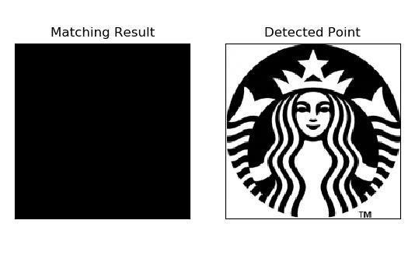
F
Template Image
–
–
ge

Slide 5
Existing System
The previous work on “Shape matching and object recognition using shape contexts,” and “ANSIG—An analytic signature for permutation-invariant two dimensional shape representation,” have used different global descriptors of the full logo image either accounting for logo contours or exploiting shape descriptors such as shape context. A two-stage algorithm proposed in “Logo detection based on spatial-spectral saliency and partial spatial context,” that accounts for local contexts of key points
Disadvantages of Existing System:
• Less Accuracy

Slide 6
Proposed System
In this project we have used CNN (convolution neural network) algorithm to classify logo as fake or original. CNN is a type of deep learning model for processing data that has a grid pattern, such as images, which is inspired by the organization of animal visual cortex and designed to automatically and adaptively learn spatial hierarchies of features, from low to high-level patterns
Advantages of Proposed System:
• High Accuracy

Slide 7
Design
Class Diagram

Slide 8
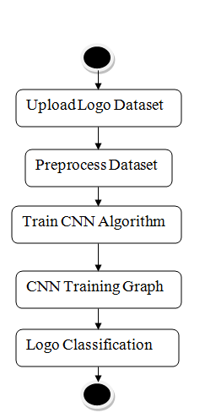
Activity Diagram

Slide 9



SOFTWARE AND HARDWARE REQUIREMENTS
Hardware requirements
Processor - Intel i3(min)
• Speed - 1.1 GHz
• RAM - 4GB(min)
• Hard Disk - 500 GB
• Key Board - Standard Windows Keyboard
Software requirements
Browser :Any latest browser like chrome operating
System : Windows 10
Language : Python

Slide 10
Applications
Brand Monitoring
Intelligent Transportation
Copyright and Trademark Compliance
Document Categorization
Certifications

Slide 11

Results

Slide 12
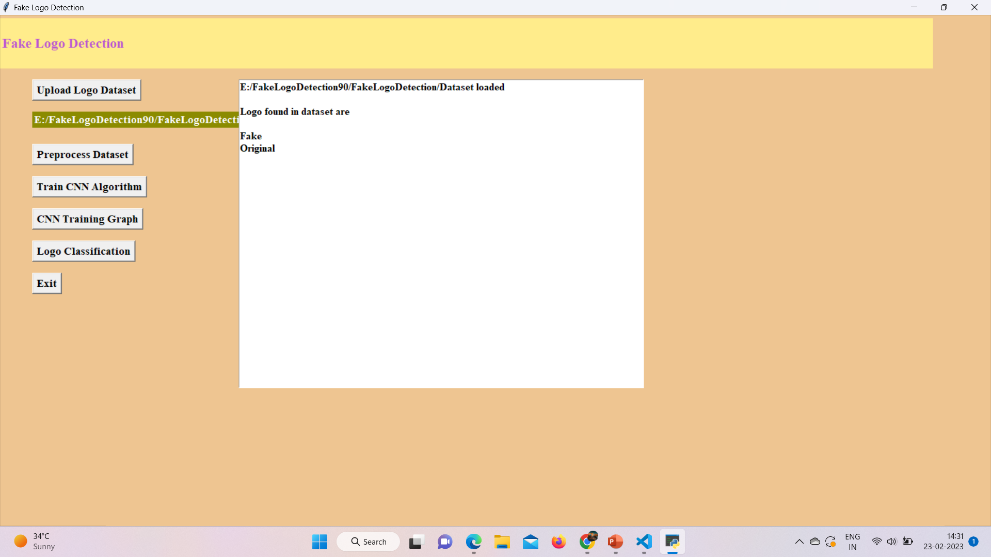
Upload Logo Dataset

Slide 13

Preprocess Dataset

Slide 14

Train CNN Algorithm

Slide 15
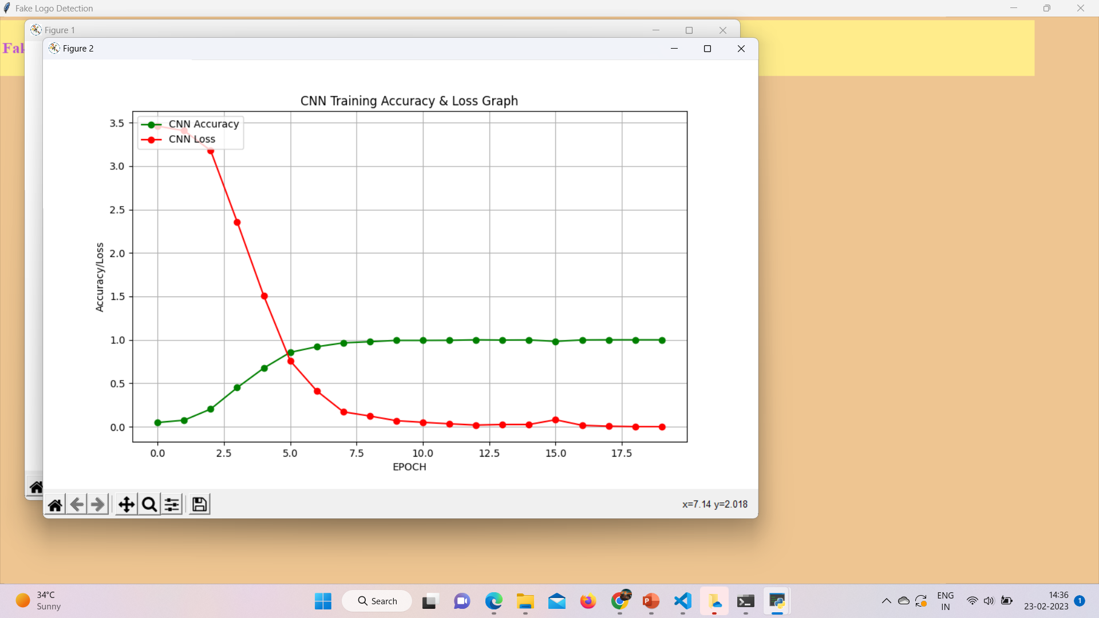
CNN Training Graph

Slide 16
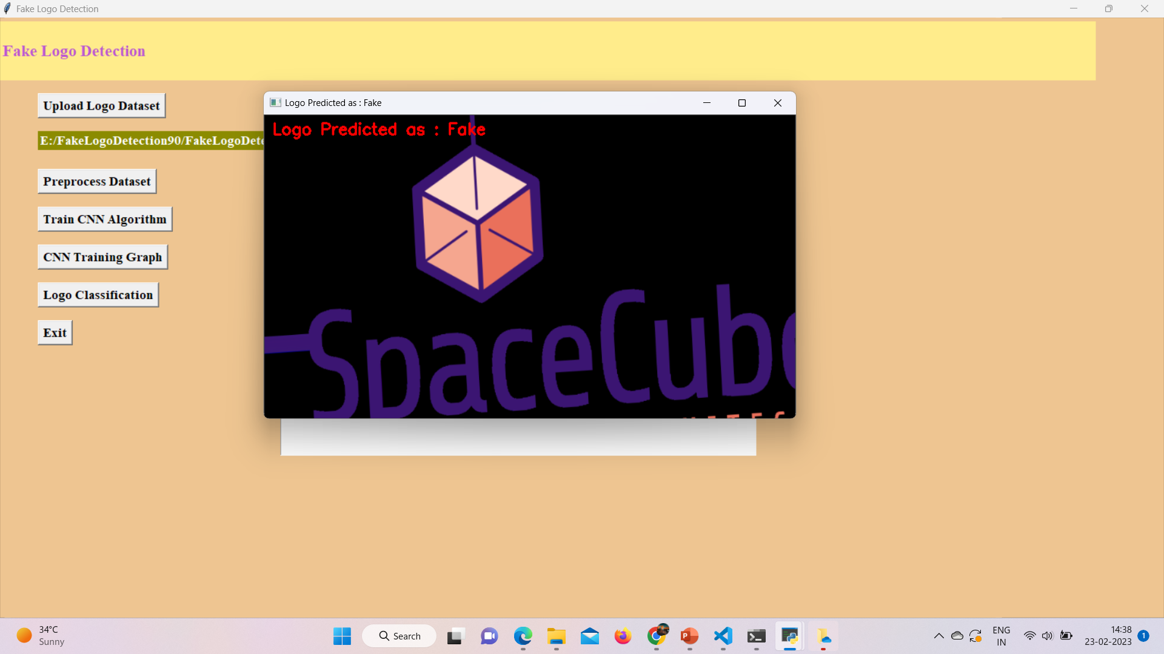
Logo Classification

Slide 17


Slide 18
Conclusion
With logo detection, it’s easier to prevent fraud and keep a specific brand safe from counterfeit attempts. Adding this tool to a company’s protection strategy can help find fraudulent or harmful content involving a brand on any online platform.

Slide 19


